Slide 1

INTRODUCTION
EASY
ADVANCED

Slide 2

INTRODUCTION
In this project, we will learn how to define and invoke lambda functions in AWS. Lambda is the most popular and used service in AWS.
AWS lambda free developers from the worry of provisioning resources, specifying operating systems, managing Hardware, and performing maintenance.
Simply write your code and run it on Lambda!

Slide 3
KEY LEARNING OUTCOMES
Understand Machine Learning workflow automation using AWS Lambda, Step functions and SageMaker Pipelines.
Learn how to define a lambda function in AWS management console.
Understand the anatomy of Lambda functions.
Learn how to configure a test event in Lambda.
Monitor Lambda invocations in CloudWatch.

Slide 4
ML WORKFLOWS 101
EASY
ADVANCED

Slide 5
ML WORKFLOW AUTOMATION
So far, we have been manually performing AI/ML model training, testing and deployment.
Now, we would like to automate the process using Lambda, step functions and SageMaker Pipelines.
This is critical to improve efficiency, reduce complexity and reduce human error.
AWS Lambda
A serverless event driven service that is perfect for mini tasks that are repeated frequently. AWS lambda empowers anyone to run code without thinking about servers or underlying infrastructure.
AWS Step Functions
allows for creating serverless workflows in which the output from a step is fed as an input to the next step.
AWS Step functions converts a workflow into a state machine diagram that’s easy to debug and understand.
AWS SageMaker Pipelines
Is a specialized continuous integration and continuous delivery (CI/CD) service for machine learning. With SageMaker Pipelines, you can create, automate, and manage end-to-end ML workflows at scale.

Slide 6
DATA COLLECTION & PRE-PROCESSING
MODEL TRAINING
MODEL EVALUATION
MODEL DEPLOYMENT
WHAT IS A ML WORKFLOW?
Machine learning workflows is an orchestrated series of steps that include: (1) data collection and pre-processing, (2) model training and refinement, (3) evaluation, and (4) deployment to production.
This process needs to be repeated frequently if data becomes available or if a new model is trained and ready for deployment in production.
The end of each step should kick start the next step! For example, if the trained ML model meets a certain KPI, it should be ready for deployment in production.

Slide 7
ML WORKFLOW EXAMPLE
This is an example of an automated ML workflow.
If data becomes available, an ETL and training jobs are launched.
Trained model is evaluated and if accuracy exceeds 92%, model is deployed in production.
A new endpoint is created and replaces the existing one.
Keep the existing endpoint
Start
Perform ETL (Extract, Transform and Load)
Launch a ML Model Training Job
Save Model
Model inference using batch processing job
Accuracy > 92%
End
Deploy a new endpoint

Slide 8
WHAT IS AWS LAMBDA?
EASY
ADVANCED

Slide 9
AWS LAMBDA 101
AWS lambda free developers from the worry of provisioning resources, specifying operating systems, managing Hardware, and performing maintenance.
Simply write your code and run it on Lambda! You only pay per milliseconds for the compute power so no need to provision infrastructure upfront.
AWS lambda is one of the most frequently used services in AWS.
Link to documentation: https://aws.amazon.com/lambda/
Serverless applications offer the following benefits:
No infrastructure management required
Autoscaling based on demand
Pay for value – due to autoscaling
High Security – AWS manages this on your behalf with shared responsibility model
High availability

Slide 10
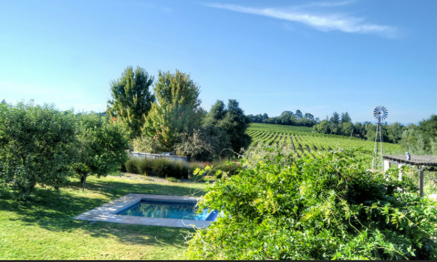



AWS LAMBDA 101
AWS lambda empowers anyone to run code without thinking about servers or underlying infrastructure (you don’t have to specify t2.medium as an example anymore).
AWS Lambda is serverless event driven service that is perfect for mini tasks that are repeated frequently.
AWS Lambda works as an orchestrator between multiple decoupled AWS Services.
User took a photo and uploaded it
S3 BUCKET
LAMBDA TRIGGER
LAMBDA FUNCTION
FILTERED PHOTO DISPLAY
Photo is uploaded and stored in Amazon S3 Bucket
Lambda function is triggered once the photo is uploaded to S3
AWS Lambda consumes photo and runs code to apply a filter to the image
Filtered photo is displayed into the web application
Photo Credit: https://www.flickr.com/photos/trophygeek/20113975429/in/photostream/

Slide 11
AWS LAMBDA 101
AWS Lambda function could be written in many programming languages such as Python, Java, C#, Go, Ruby, and Node.js
Lambda functions are event driven, they are triggered when an event takes place such as an object that is uploaded to S3 or request to a given endpoint.
Lambda functions can be used to invoke other AWS services.
Note that with AWS Free Tier, you have 1 Million Lambda triggers for free!
AWS Pricing is powerful and efficient:
Compute time is charged every 100ms increments
No hourly minimums
No payments for idle resources

Slide 12
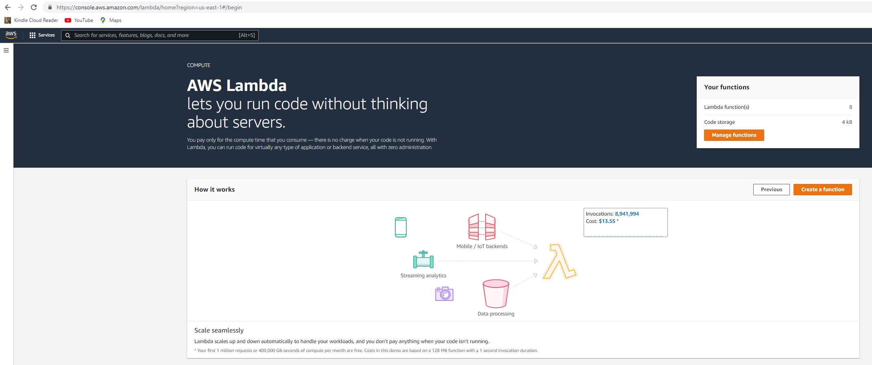
AWS LAMBDA 101: DEMO
https://console.aws.amazon.com/lambda/home?region=us-east-1#/begin

Slide 13
AWS LAMBDA 101: BENEFITS
Enhanced Agility
Reduced Costs
Fast Time to Market
No hassle in Provisioning HW and Managing SW
Allows Developers to Focus on the product

Slide 14
AWS LAMBDA 101: WHAT DOES LAMBDA HANDLE?
Load Balancing by routing requests to available instances
Autoscaling
Failures and retry
Security and isolation
Operating System Management
Utilization and Billing

Slide 15
AWS LAMBDA FUNCTION ANATOMY
EASY
ADVANCED

Slide 16
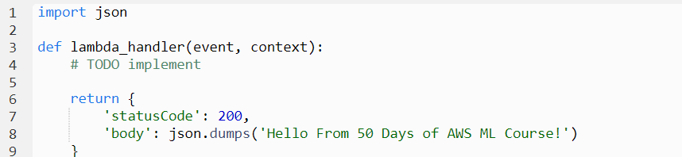
AWS LAMBDA FUNCTION ANATOMY
Handler() Function: Function to be executed upon invocation and it requires two arguments “event” and “context”.
Event Object: data sent during lambda function invocation, for example if a request is made from S3, the event object will contain the bucket key and what kind of action has been performed on the bucket.
Context object: this is generated by the platform and contains information about the underlying infrastructure and execution environment such as allowed runtime and memory.

Slide 17
DEMO: DEFINE AN AWS LAMBDA FUNCTION USING CONSOLE – EXAMPLE 1
EASY
ADVANCED

Slide 18
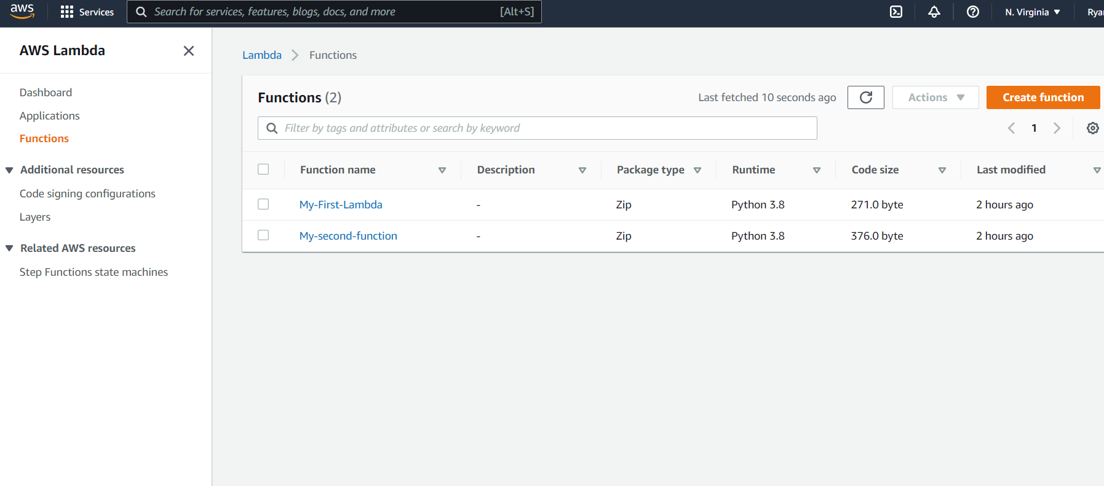
DEMO: CREATE AN AWS LAMBDA FUNCTION USING CONSOLE
GO TO AWS LAMBDA AND CLICK ON CREATE FUNCTION

Slide 19
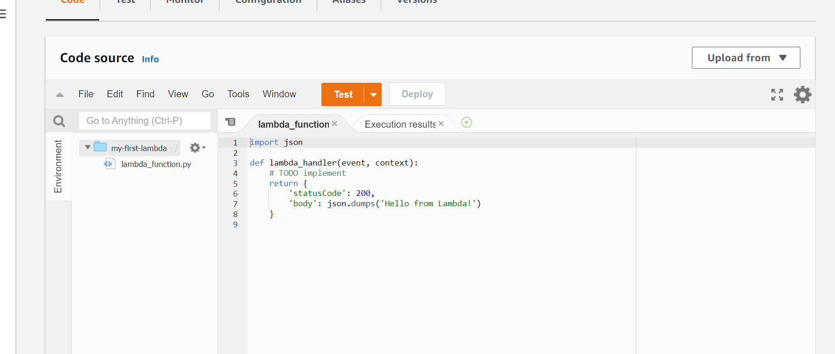
DEMO: CREATE AN AWS LAMBDA FUNCTION USING CONSOLE
THIS FUNCTION RETURNS STATUS CODE AND “HELLO FROM LAMBDA”

Slide 20
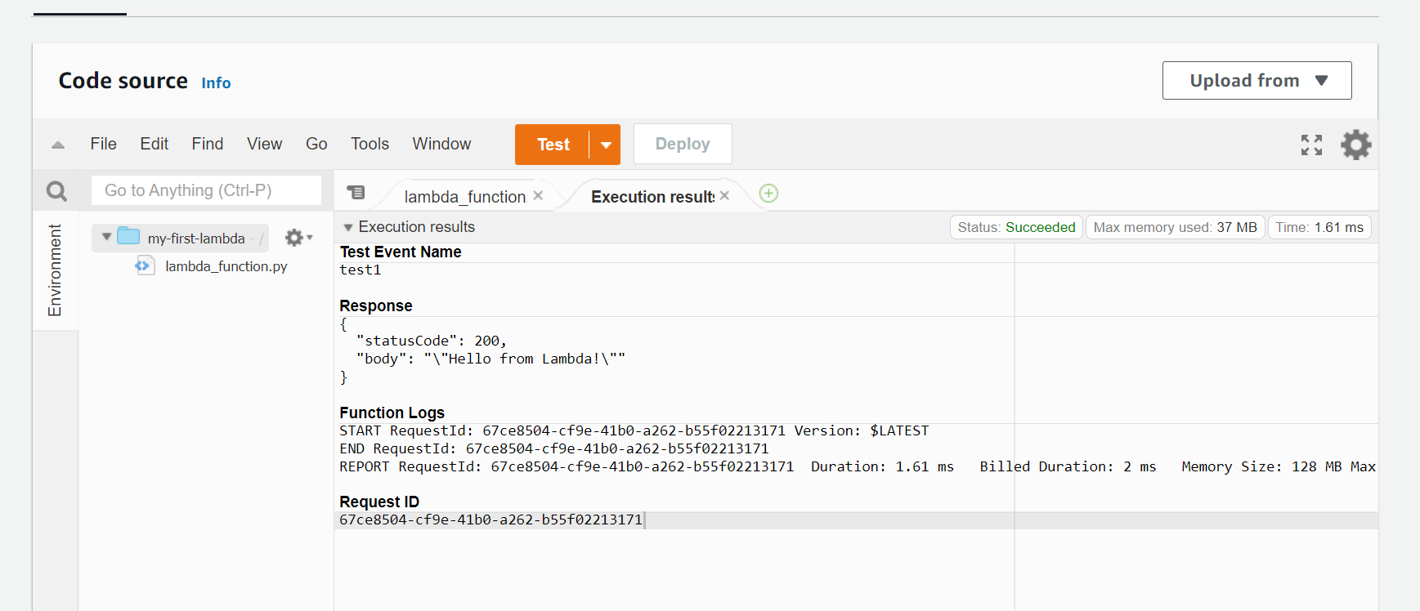
DEMO: CREATE AN AWS LAMBDA FUNCTION USING CONSOLE
CONFIGURE A TEST EVENT BELOW. A TEST EVENT IS A JSON OBJECT THAT MOCKS THE STRUCTURE OF REQUESTS EMITTED BY AWS SERVICES TO INVOKE A LAMBDA FUNCTION.

Slide 21
DEMO EXAMPLE 2: DEFINE AN AWS LAMBDA FUNCTION USING CONSOLE
EASY
ADVANCED

Slide 22
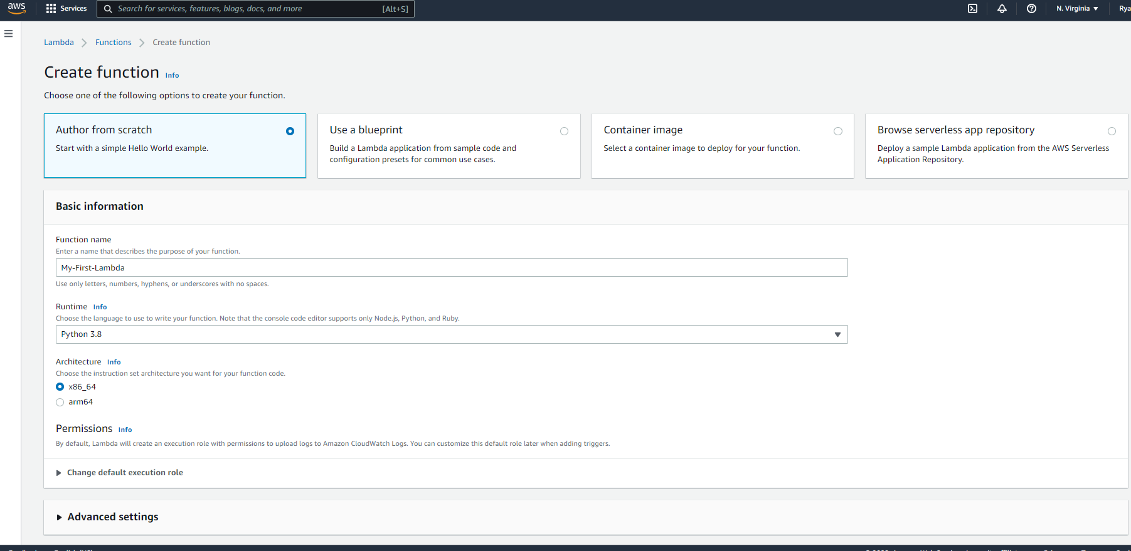
DEMO: CREATE AN AWS LAMBDA FUNCTION USING CONSOLE
SELECT AUTHOR FROM SCRATCH, GIVE A UNIQUE LAMBDA FUNCTION NAME, SELECT A RUNTIME AND CLICK CREATE FUNCTION

Slide 23
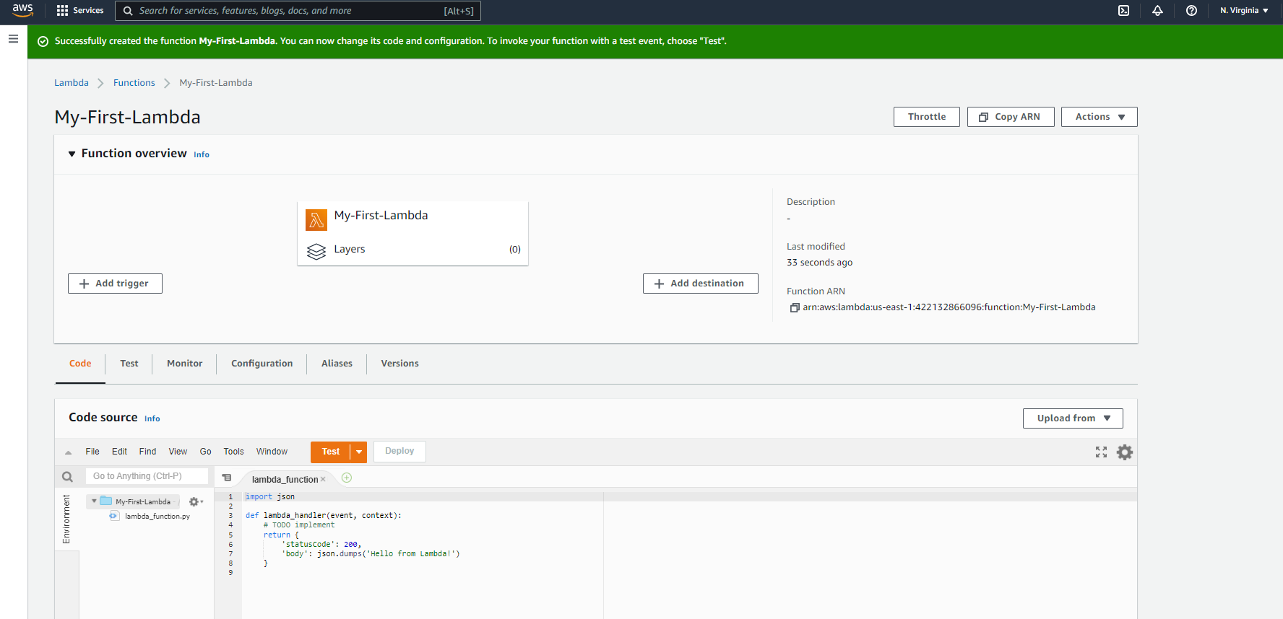
DEMO: CREATE AN AWS LAMBDA FUNCTION USING CONSOLE
WELCOME TO YOUR FIRST LAMBDA FUNCTION! YOU CAN SEE THE CODE SOURCE BELOW

Slide 24
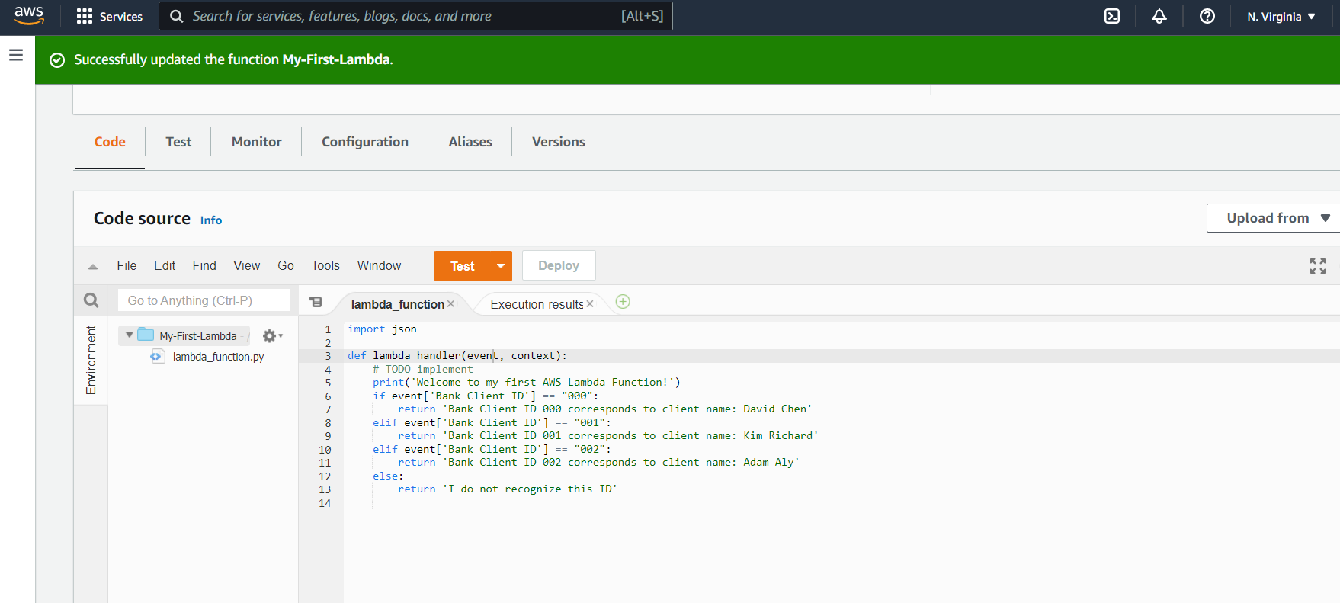
DEMO: CREATE AN AWS LAMBDA FUNCTION USING CONSOLE
WRITE THIS FUNCTION BELOW AND CLICK DEPLOY

Slide 25
DEMO EXAMPLE 2: TEST AN AWS LAMBDA FUNCTION USING CONSOLE
EASY
ADVANCED

Slide 26
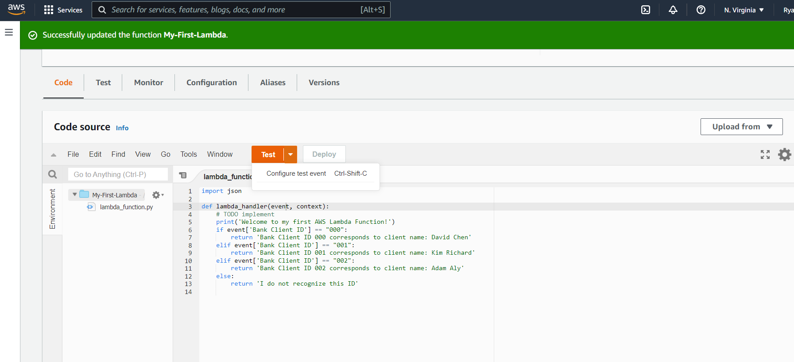
DEMO: CREATE AN AWS LAMBDA FUNCTION USING CONSOLE
LET’S TEST THIS FUNCTION, CLICK ON “CONFIGURE TEST EVENT”

Slide 27
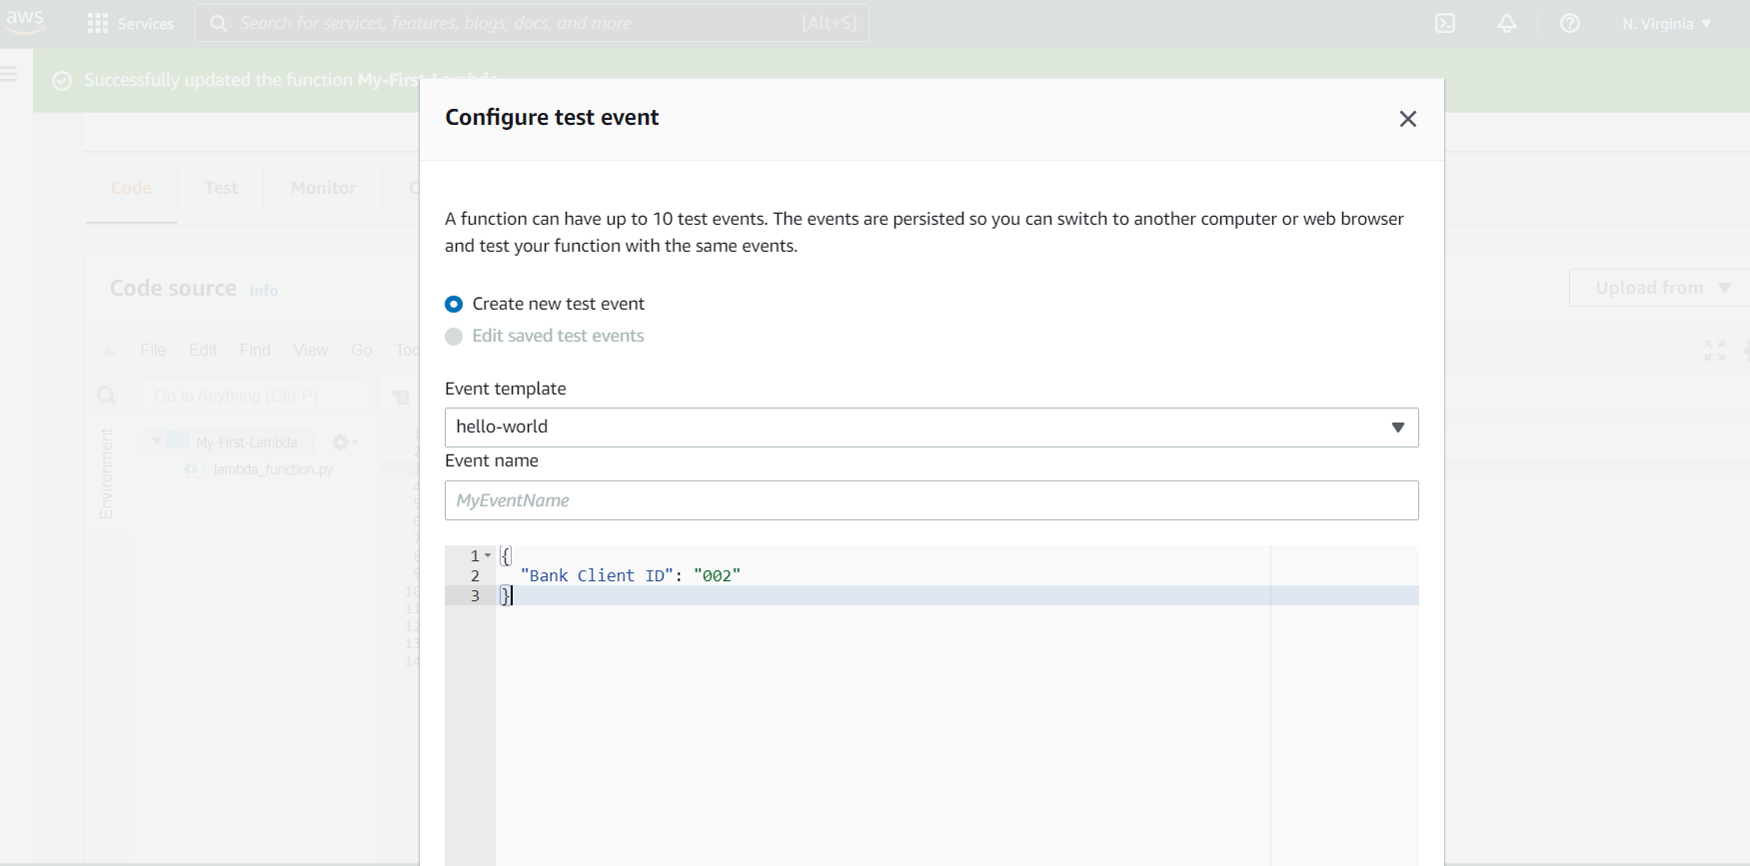
DEMO: CREATE AN AWS LAMBDA FUNCTION USING CONSOLE
PROVIDE A NAME TO THE EVENT AND CLICK “CREATE”

Slide 28
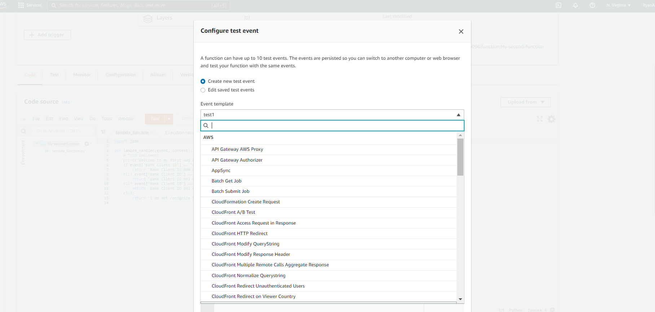
DEMO: CREATE AN AWS LAMBDA FUNCTION USING CONSOLE
NOTE THAT YOU CAN SELECT SEVERAL TEST EVENT FROM THIS MENU

Slide 29
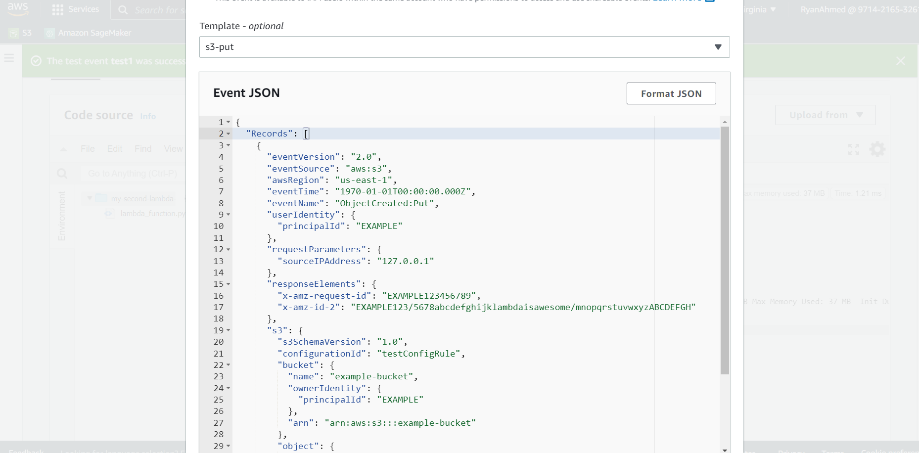
DEMO: CREATE AN AWS LAMBDA FUNCTION USING CONSOLE
EXPLORE THE S3-PUT EVENT FOR EXAMPLE

Slide 30
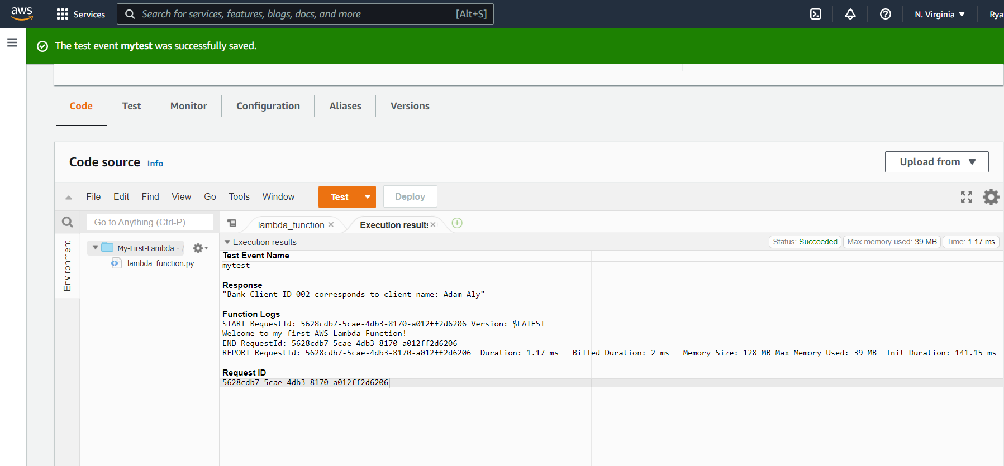
DEMO: CREATE AN AWS LAMBDA FUNCTION USING CONSOLE
CLICK TEST AND OBSERVE THE FUNCTION RESPONSE

Slide 31
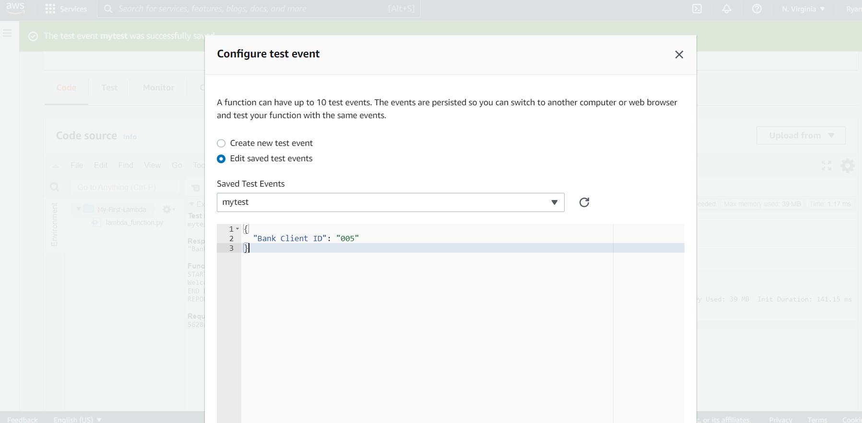
DEMO: CREATE AN AWS LAMBDA FUNCTION USING CONSOLE
LET’S TEST THE FUNCTION AGAIN BY SETTING “BANK CLIENT ID”: 005

Slide 32
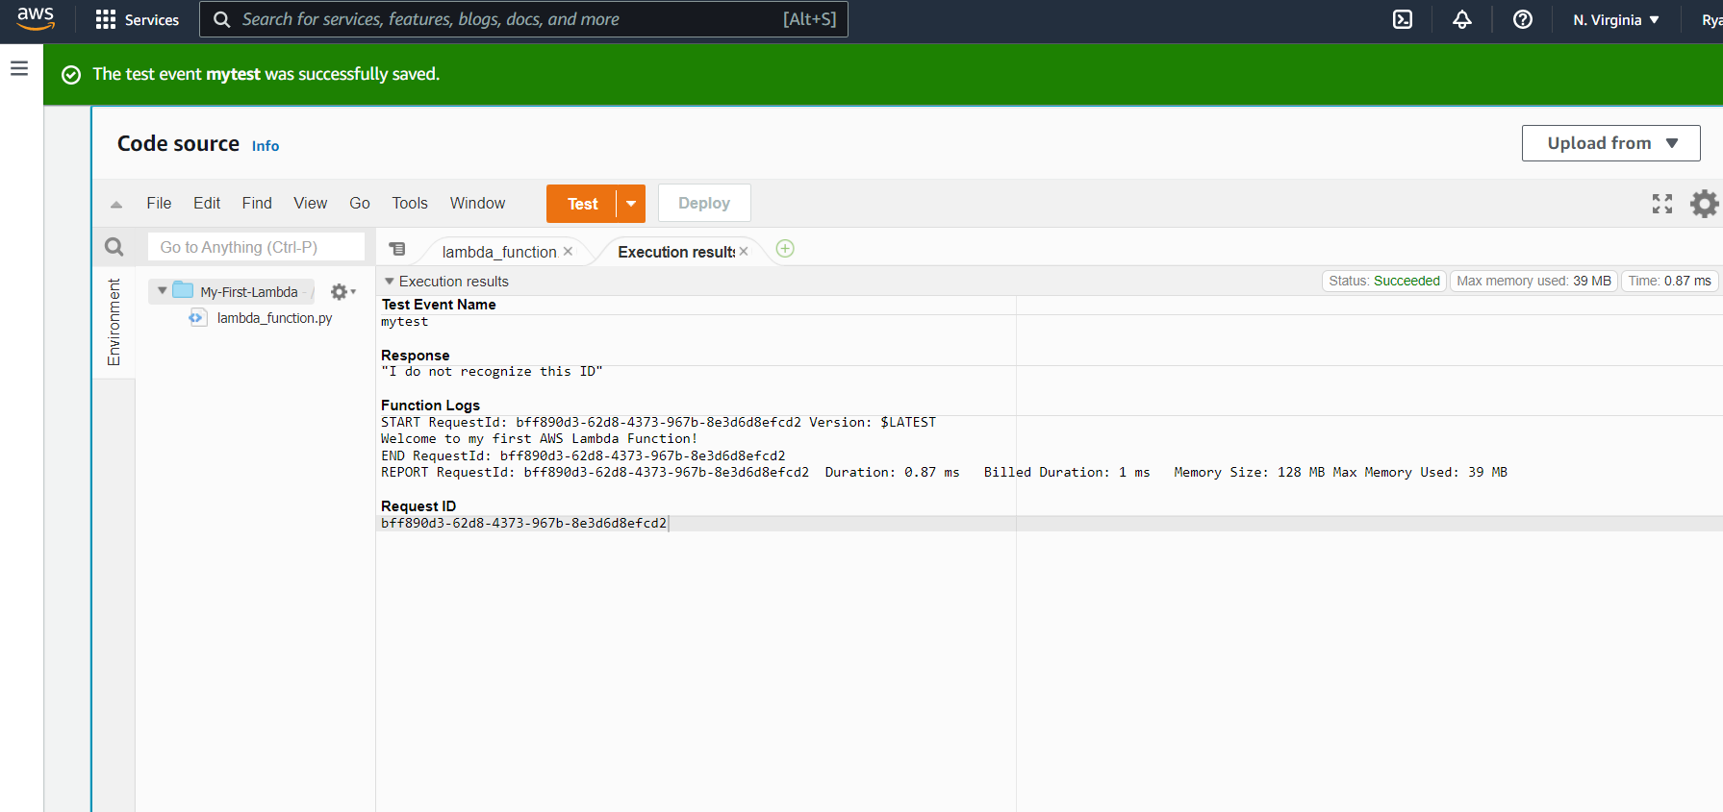
DEMO: CREATE AN AWS LAMBDA FUNCTION USING CONSOLE
NOTE THAT THE ELSE BRANCH HAS BEEN EXECUTED

Slide 33
DEMO EXAMPLE 2: MONITOR AN AWS LAMBDA FUNCTION USING CONSOLE
EASY
ADVANCED

Slide 34
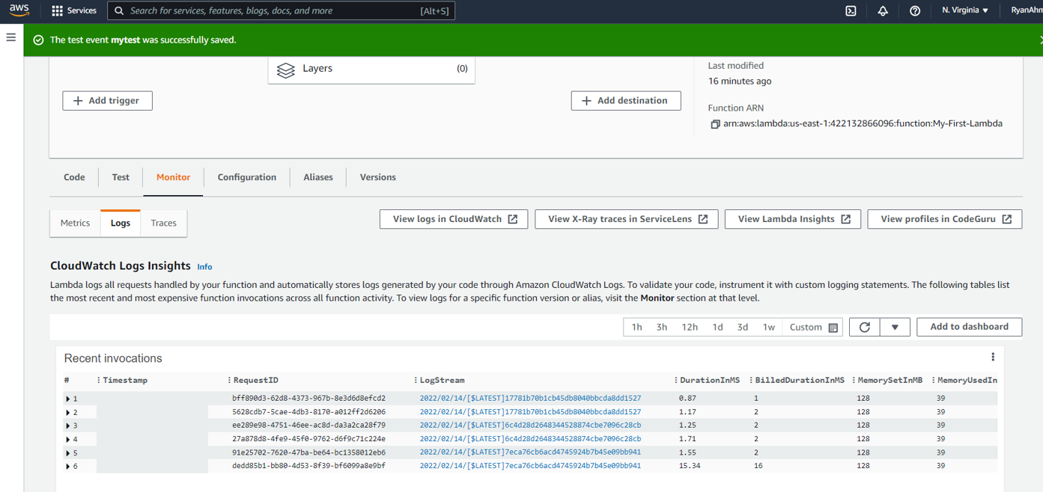
DEMO: CREATE AN AWS LAMBDA FUNCTION USING CONSOLE
GO TO MONITOR AND LOGS TO TRACK THE LAMBDA FUNCTION REQUESTS, DURATION, BILLING..ETC

Slide 35
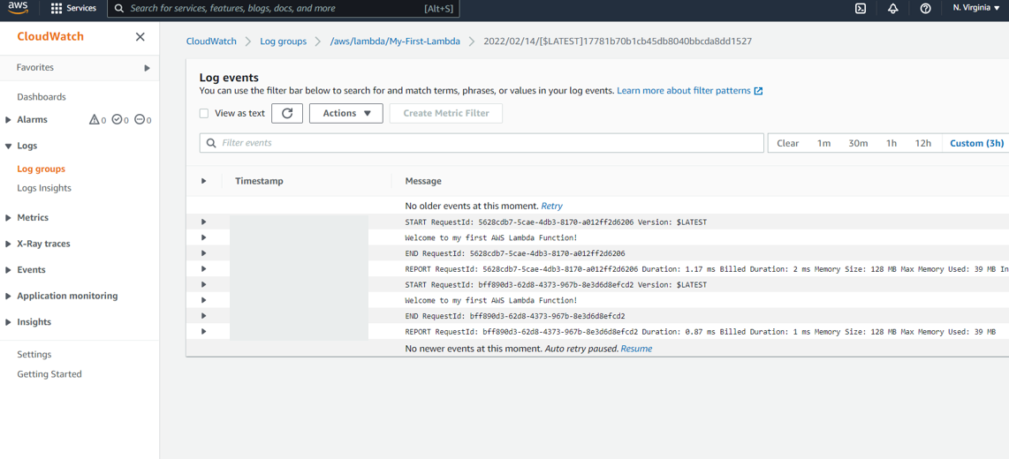
DEMO: CREATE AN AWS LAMBDA FUNCTION USING CONSOLE
CLICK ON A SAMPLE LOG EVENT TO VIEW DETAILS ON CLOUDWATCH

Slide 36
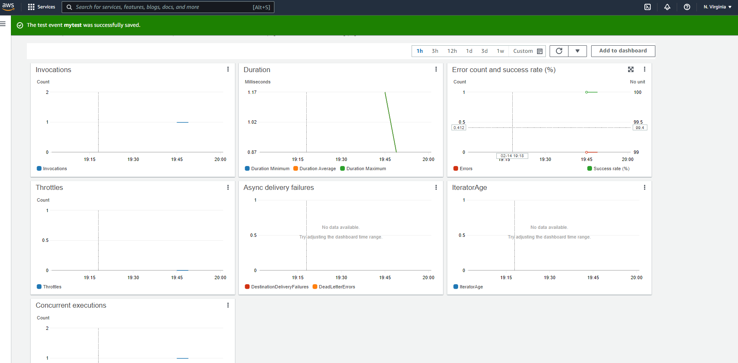
DEMO: CREATE AN AWS LAMBDA FUNCTION USING CONSOLE
GO TO MONITOR AND METRICS TO VIEW DASHBOARD WITH ALL METRICS INCLUDING INVOCATIONS

Slide 37
FINAL END-OF-DAY CAPSTONE PROJECT
EASY
ADVANCED

Slide 38
FINAL CAPSTONE PROJECT
Define a Lambda Function that takes in the number of stock units and stock price and calculates the total value of the portfolio.
Return the total value of the portfolio.
Configure the following test events:
Assume that the default currency in the previous lambda function is in USD, we would like to enhance this function to either return USD or CAD currencies (assume exchange rate 1 USD = 1.3 CAD).
Define and test the new Lambda Function.
Stock Units = 20, stock value = $1000
Stock Units = 5, stock value = $2000

Slide 39
FINAL END-OF-DAY CAPSTONE PROJECT SOLUTION
EASY
ADVANCED

Slide 40
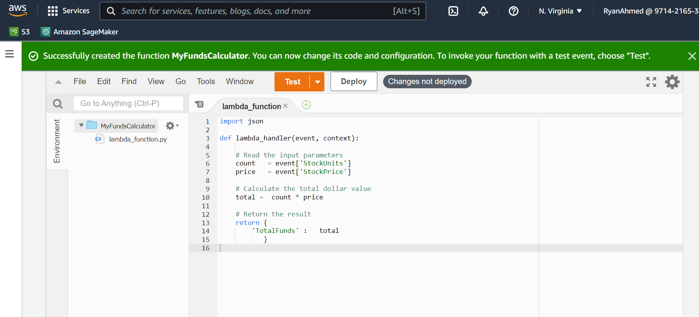
FINAL CAPSTONE PROJECT SOLUTION

Slide 41
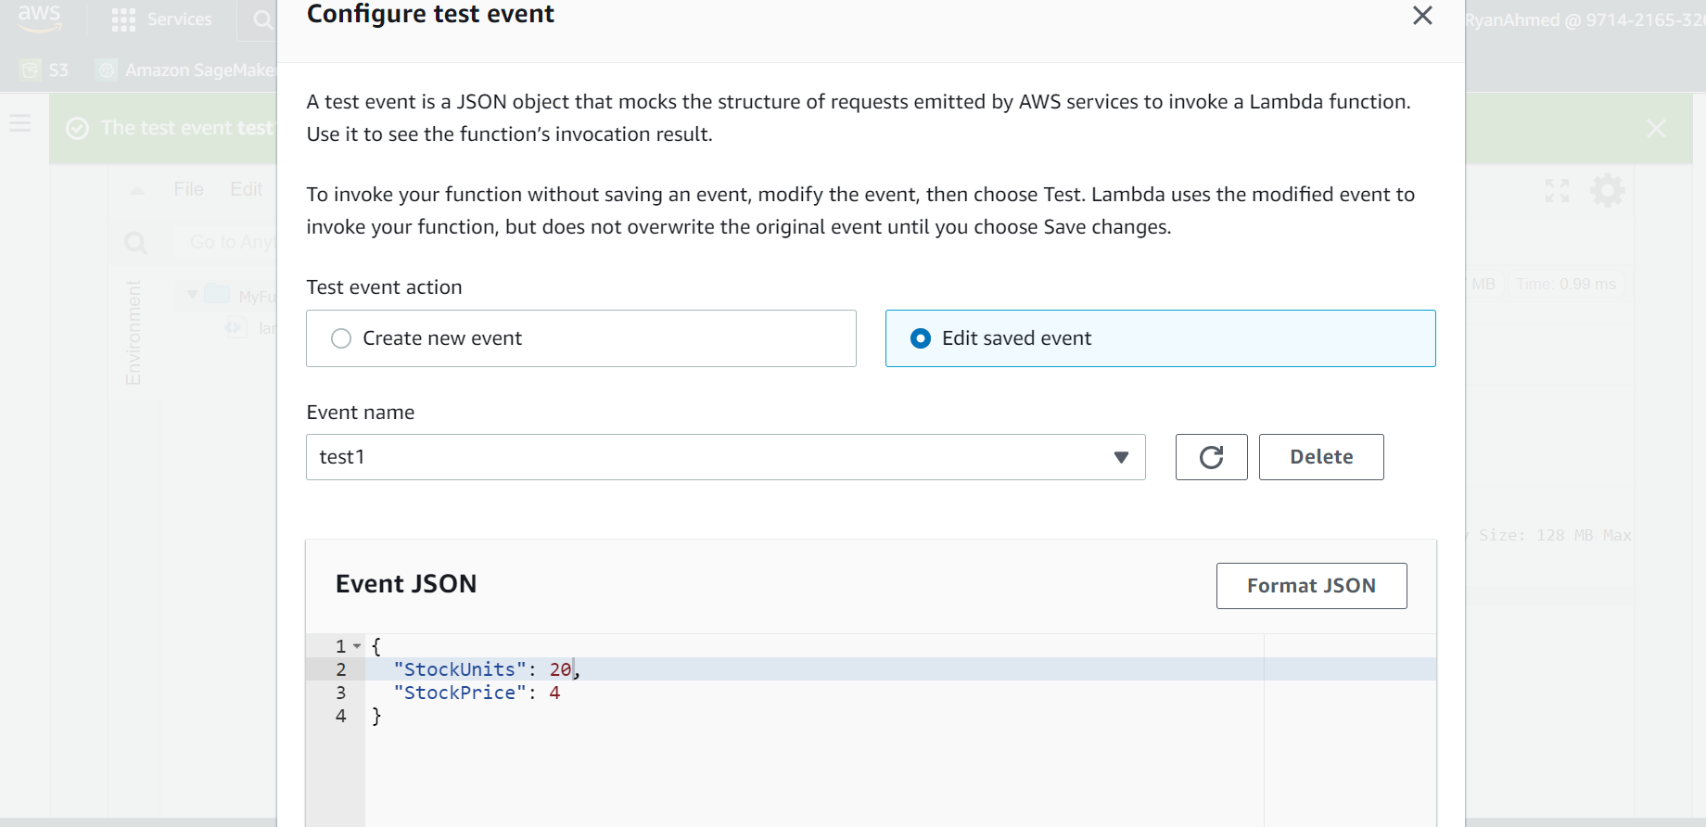
FINAL CAPSTONE PROJECT SOLUTION

Slide 42
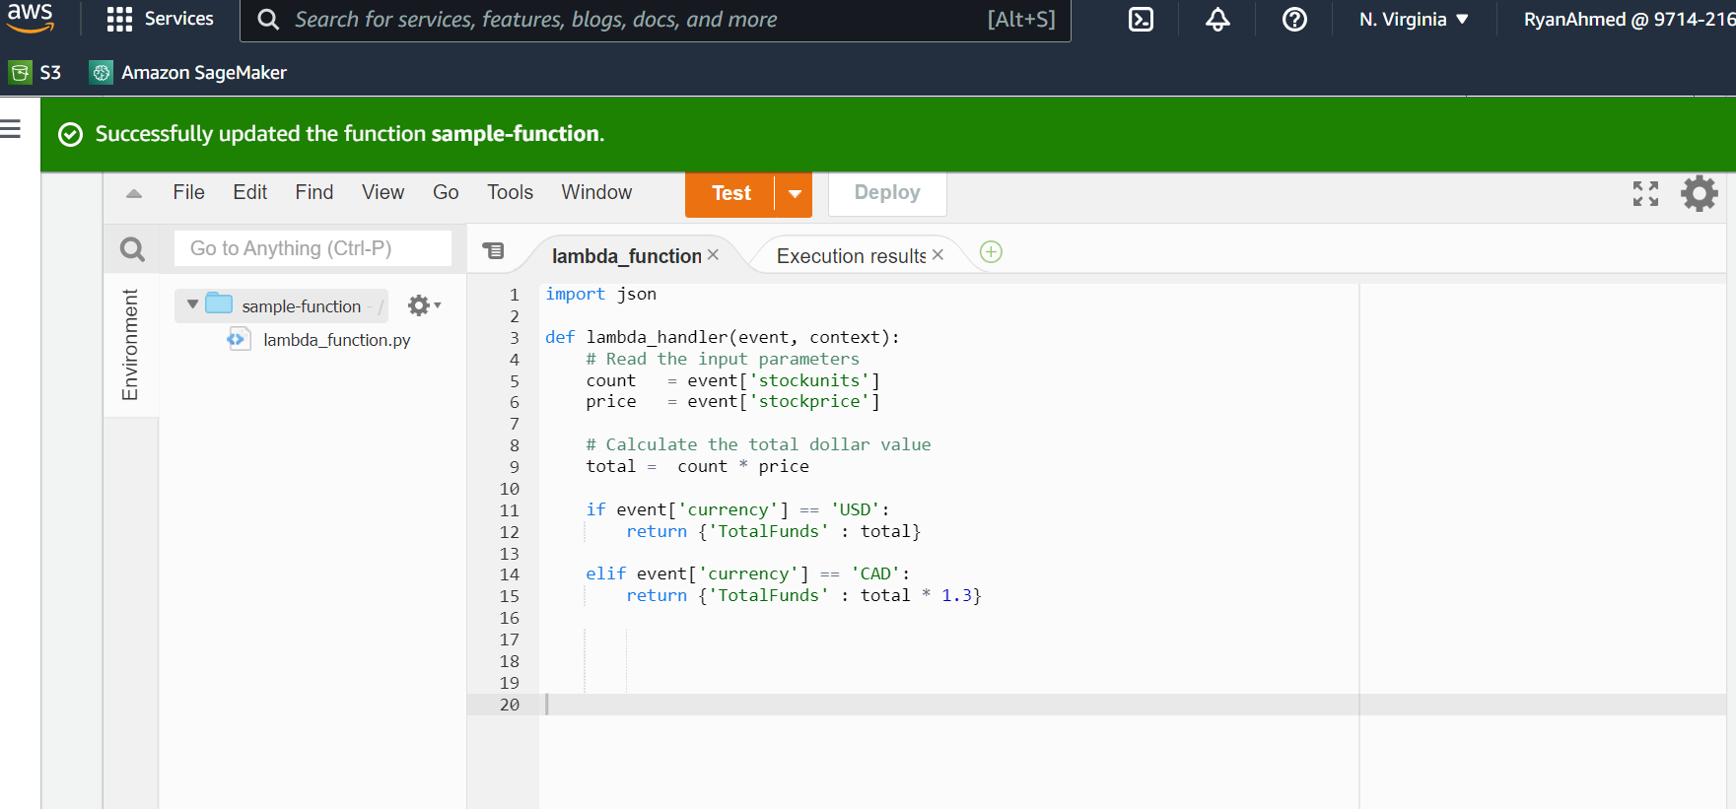
FINAL CAPSTONE PROJECT SOLUTION

Slide 43
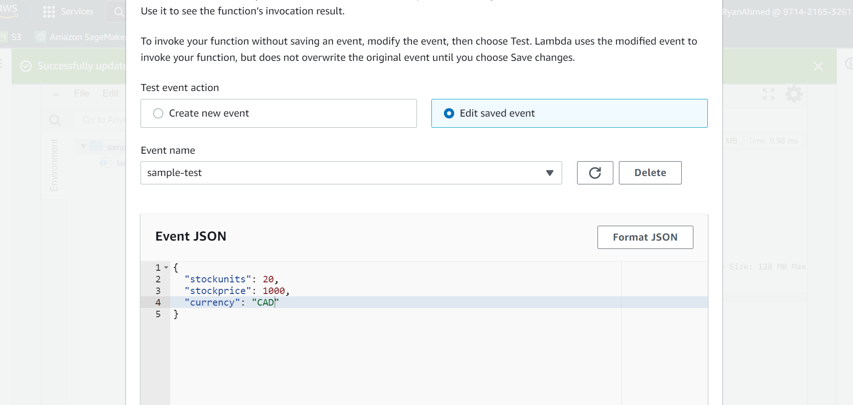
FINAL CAPSTONE PROJECT SOLUTION

